Slide 1
C程式設計實驗(二)
Chapter9. Operator Overloading (2)

Slide 2
Friend Functions
Nonmember Functions
Recall: operator overloads as nonmembers
They access data through accessor and mutator functions.
Very inefficient (overhead of calls)
Friends can directly access private class data
No overhead, more efficient.
Best to make nonmember operator overloads friends !

Slide 3
Overloading >> and << (1 / 4)
Improves readability
Like all operator overloads do.
Enables :
cout << myObject;
cin >> myObject;
Instead of the need for :
myObject.output();

Slide 4
Overloading >> and << (2 / 4)
Example (declaration)
class Money {
int dollars, cents;
public:
friend ostream& operator << (ostream& outs, const Money & amount);
friend istream& operator >> (istream& ins, Money& amount);
};

Slide 5
Overloading >> and << (3 / 4)
Example (definition)
ostream& operator << (ostream& outs, const Money& amount){
outs << amount.dollars << "." << amount.cents;
return outs;
}
istream& operator >> (istream& ins, Money& amount) {
ins >> amount.dollars;
ins >> amount.cents;
return ins;
}

Slide 6

Overloading >> and << (4 / 4)
Example (calling)
int main () {
Money yourAmount;
cin >> yourAmount;
cout << "Your amount is " << yourAmount << endl;
return 0;
}

Slide 7
C程式設計實驗(二)
Chapter10. String

Slide 8
C - String
Array with base type “char”
One character per indexed variable.
End of string marked with null, “\0” → null character
Example
0
1
2
3
4
5
index
Hello →
H
e
l
l
o
\0

Slide 9
C - String Variable
Typically “partially - filled” array
Declare large enough to hold a max-size string.
Indicate end with null.
The only difference from a standard array :
Must contain null character.
Example. (char s[10])
Declares a c-string variable to hold up to 9 characters.
The last: null character “\0”.

Slide 10
C - String initialization
Two ways to initialize c-string
char Message[20]
Need not fill the entire array.
char shortString[] = “abc”;
Can omit array size.
Automatically makes size one more than the length of a quoted string.
NOT same as :
char shortString[] = {‘a’, ’b’, ’c’};

Slide 11
C - String Storage
char s[10];
If s contains string: “Hi Mom!”, store as :

Slide 12
C - String Output / Input
Output
Can output with insertion operator, <<
Input
Can input with extraction operator, >>
Watch the size of the c-string.
Whitespace is a “delimiter”
Tab, space, and line breaks are “skipped”.
Input reading “stops” at delimiter.

Slide 13
Library <cstring> : strlen( )
String length
Useful to know string length.
The null character is not counted in the length.

Slide 14
Library <cstring> : strcat( )
String concatenate
Be careful!
Incorporate spaces as needed.

Slide 15


Library <cstring> : strcat( )
Core Dumped!

Slide 16
Library <cstring> : strcpy( )
String copy
strcpy(Target_string , Src_string)
strncpy(Target_string , Src_string , limit)

Slide 17
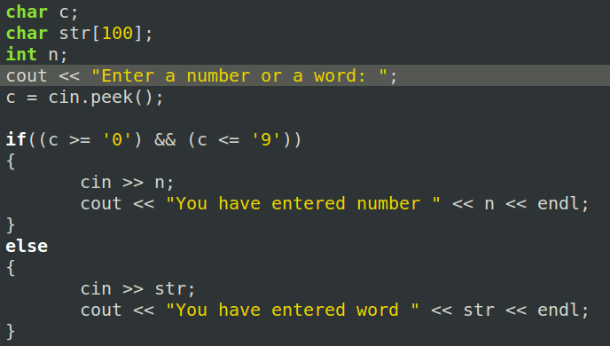


Member Function peek( )
Return next char but leaves it there.
peekchar = cin.peek();

Slide 18
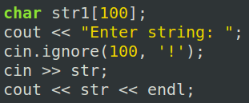

Member Function ignore( )
Skip input, up to designated character.
cin.ignore(100, ‘!’);
Skips at most 100 characters until ‘!’ .

